Slide 1
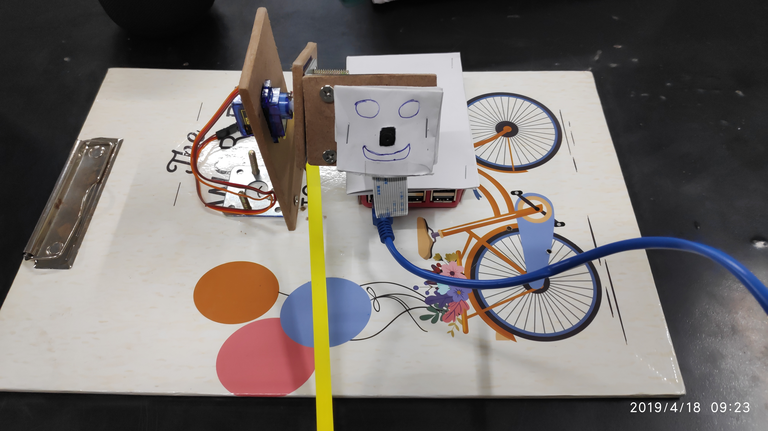
Emotion Recognition Robot

Slide 2
Components used
Raspberry Pi 3 B+
Pi Camera
Servo Motor (SG-90)
Laptop (As a server)
WiFi module

Slide 3
Technology used
Convolutional Neural Network (CNN)
Web-socket Protocol
Python Programming Language
OpenCV Image Processing
Tensor Flow-GPU

Slide 4
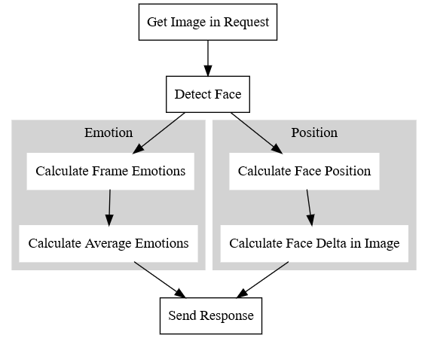
Part 1 working(Flowchart)

Slide 5
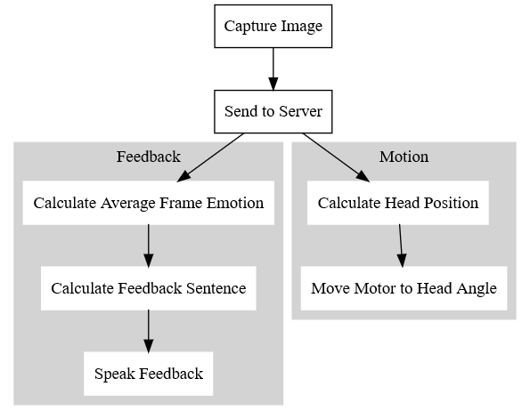
Part 2 working(Flowchart)

Slide 6
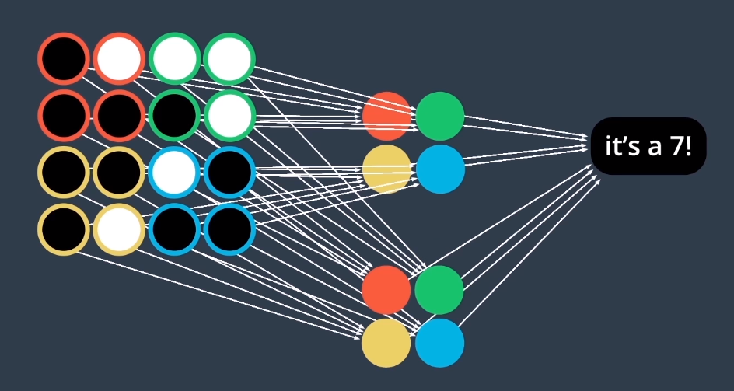
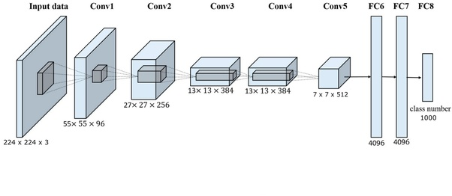
Convolutional Neural Networks (CNN)
A convolutional neural network (CNN) is a type of artificial neural network used in image recognition and processing that is specifically designed to process pixel data. CNNs are powerful image processing, artificial intelligence (AI) that use deep learning to perform both generative and descriptive tasks, often using machine vison that includes image and video recognition, along with recommender systems and natural language processing (NLP).
Two CNN Filters Identifying Digit 7

Slide 7

OpenCV Image Processing
Most popular computer vision library.
OpenCV is a cross-platform library to develop real-time computer vision applications.
It mainly focuses on image processing, video capture and analysis.
Includes features like face detection and object detection.
It contains more than 2500 optimized algorithms, which includes a comprehensive set of both classic and state-of-the-art computer vision and machine learning algorithms.

Slide 8

TensorFlow
The most famous deep learning made by the Google Brain team.
It is called TensorFlow because it takes input as a multi-dimensional array, also known as tensors.
A flowchart of operations (called a Graph) can be performed on the input.
The tensors are fed as input which then flow through this system of multiple operations called a graph, to finally give a required output.

Slide 9
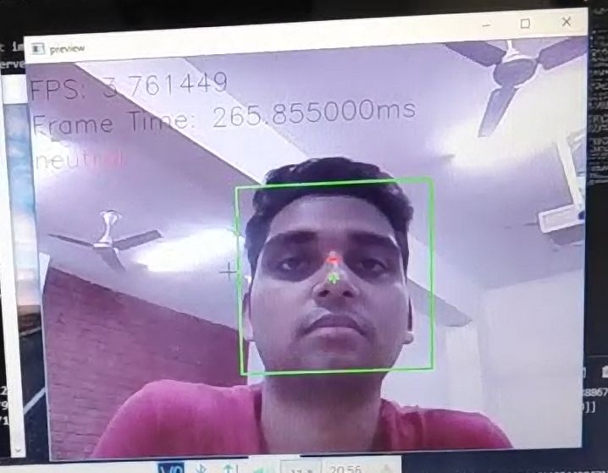
neutral

Slide 10
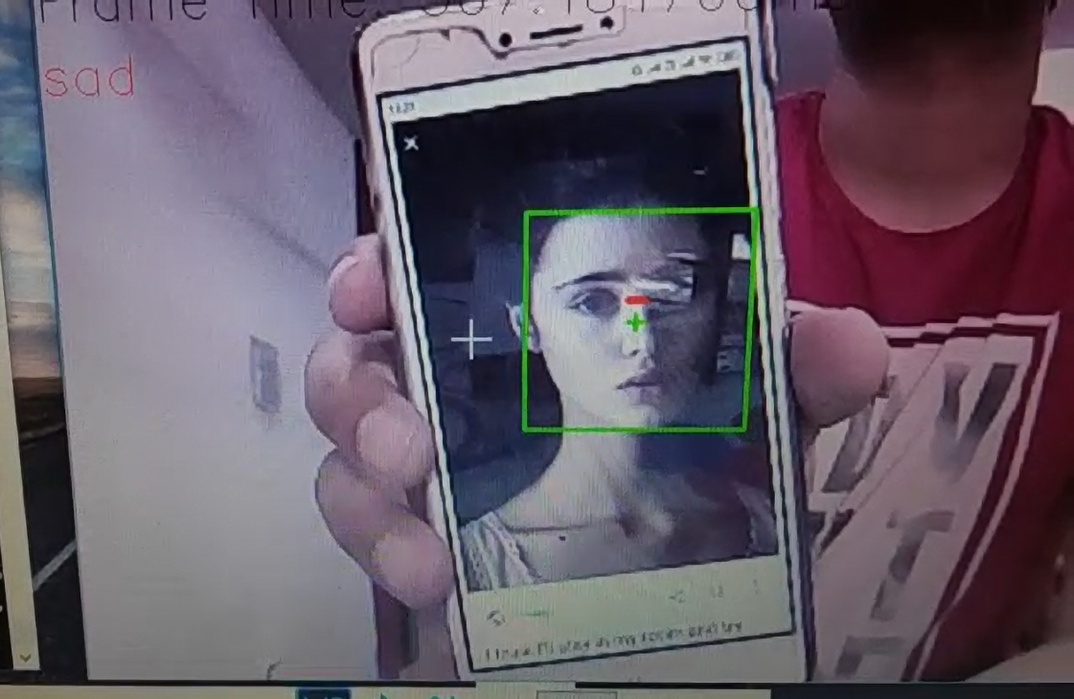
sad

Slide 11
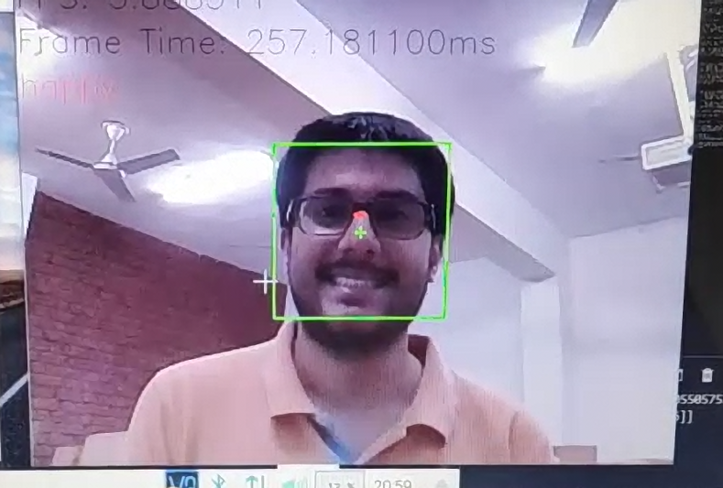
happy

Slide 12
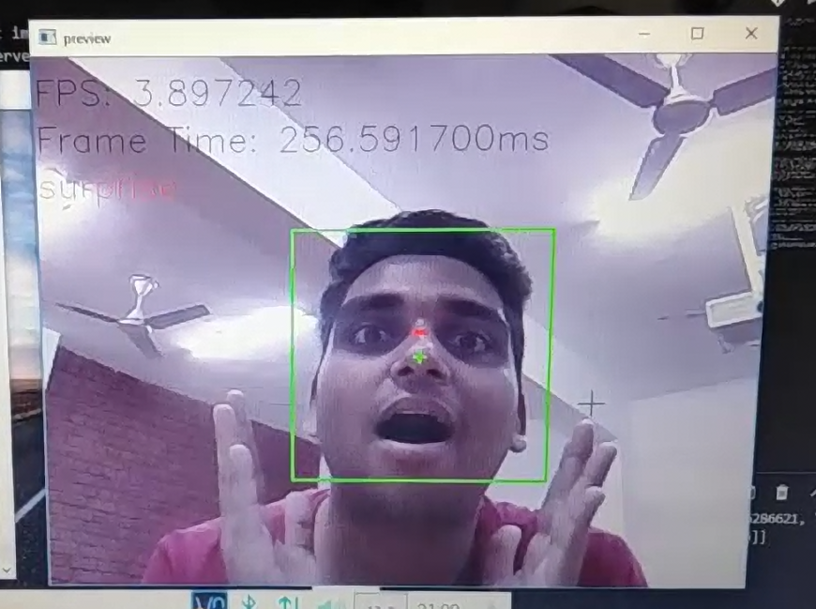
surprise

Slide 13
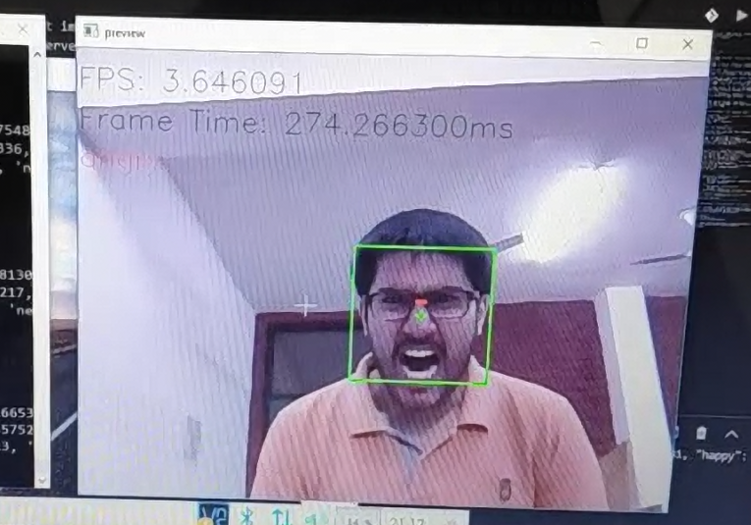
angry

Slide 14
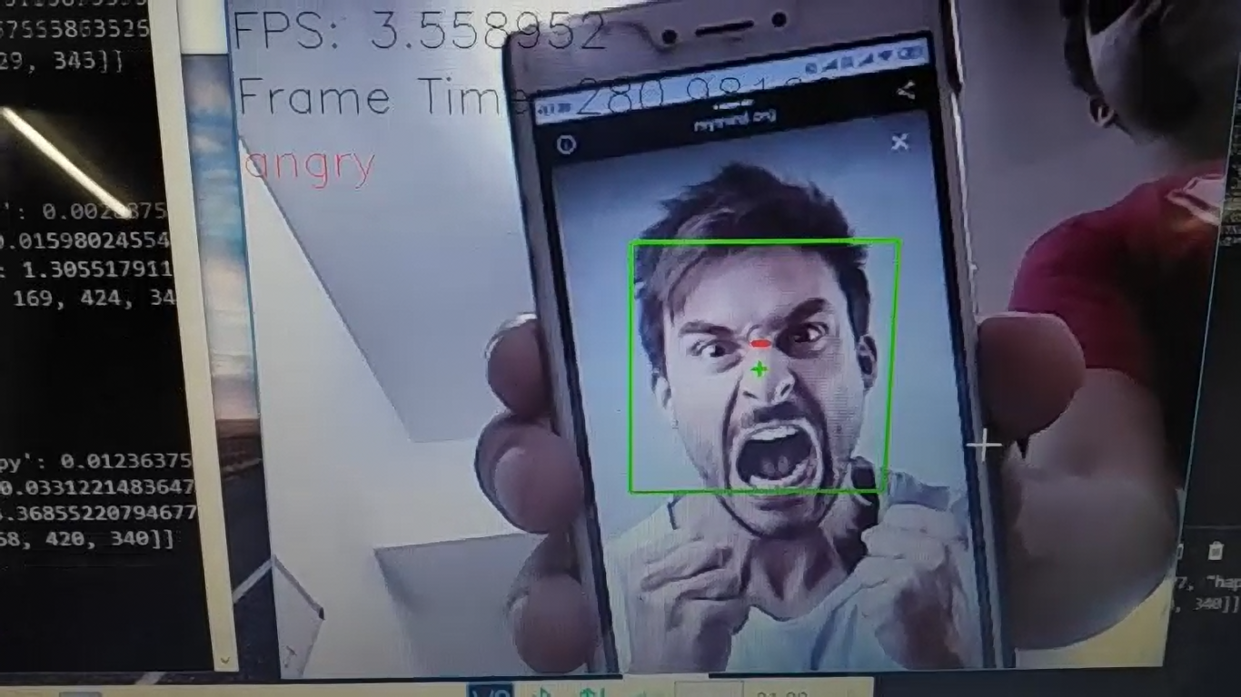
angry

Slide 15
Use Case
Advertising- The following model can be made into a human figure and used for advertisements outside of shops
Play school- This model can be used in schools to talk with children, this will develop talking habit in kids and accelerate their growing rate.

Slide 16
Thank You!!!

